Slide 1

NAME : PRITESH PANCHAL
CLASS : IT-1(SY)
SUBJECT : EEM
EN. NO. : 160410116069

Slide 2
UNEMPLOYMENT
Those who able and want to work at expected reward for work, but anyone are not offered the job them.
Unemployment Rate(in%) = Unemployed Workers
Total Work Force
100

Slide 3
TYPES OF UNEMPLOYMENT
(1) Voluntary unemployment :
1. Job is not offered at a place of his choice.
2. Job tasks are not suiting to his skills.
3. Job does not offer the salary as per his qualification ,
experiences , expectations.
(2) Involuntary unemployment :
1. Economic conditions like Depression , recession , economic
slow downs etc.
2. Mismatch between job requirements.

Slide 4
Involuntary
Unemployment
Structural
Cyclical
Frictional
Disguised
Seasonal

Slide 5
Policies to reduce Unemployment
NAREGA
Sampoorna Grameen Rozgar Yojna
Swarna Jayanti Gram Swarozgar Yojna
Prime Minister’s Employment Generation Programme
National Food for Work Programme
Prime Minister's Integrated Urban Poverty Eradication Program (PMIUPEP)
The Swaran Jayanti Rozgar Yojana
Jawahar Gram Samridhi Yojana

Slide 6
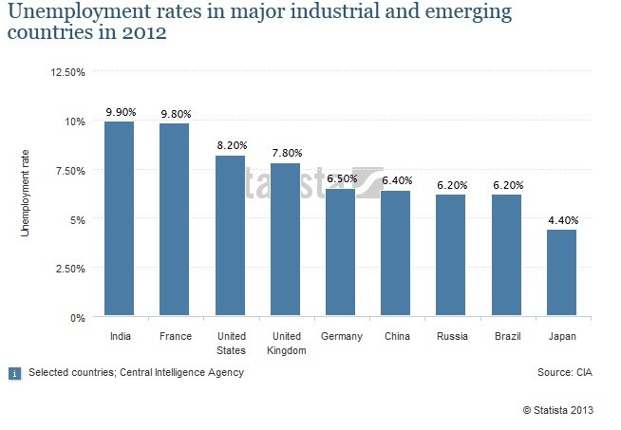

Slide 7


Examples
In 2016, Snapdeal fired thair 600 employees.
Some reports suggest LeEco is exiting India, cutting down 85% of its staff.

